Slide 1
Algorithm Analysis and Recursion

Slide 2
Algorithm
An algorithm is a set of instructions to be followed to solve a problem.
There can be more than one solution (more than one algorithm) to solve a given problem.
An algorithm can be implemented using different programming languages on different platforms.
An algorithm must be correct. It should correctly solve the problem.
e.g. For sorting, this means even if (1) the input is already sorted, or (2) it contains repeated elements.
Once we have a correct algorithm for a problem, we have to determine the efficiency of that algorithm.

Slide 3
Algorithmic Performance
There are two aspects of algorithmic performance:
Time
Instructions take time.
How fast does the algorithm perform?
What affects its runtime?
Space
Data structures take space
What kind of data structures can be used?
How does choice of data structure affect the runtime?
We will focus on time:
How to estimate the time required for an algorithm
How to reduce the time required

Slide 4
Analysis of Algorithms
Analysis of Algorithms is the area of computer science that provides tools to analyze the efficiency of different methods of solutions.
How do we compare the time efficiency of two algorithms that solve the same problem?
Naïve Approach: implement these algorithms in a programming language (C++), and run them to compare their time requirements.

Slide 5
Analysis of Algorithms
Comparing the programs (instead of algorithms) has difficulties.
How are the algorithms coded?
Comparing running times means comparing the implementations.
We should not compare implementations, because they are sensitive to programming style that may cloud the issue of which algorithm is inherently more efficient.
What computer should we use?
We should compare the efficiency of the algorithms independently of a particular computer.
What data should the program use?
Any analysis must be independent of specific data.

Slide 6
Analysis of Algorithms
When we analyze algorithms, we should employ mathematical techniques that analyze algorithms independently of specific implementations, computers, or data.
To analyze algorithms:
First, we start to count the number of significant operations in a particular solution to assess its efficiency.
Then, we will express the efficiency of algorithms using growth functions.

Slide 7
The Execution Time of Algorithms
Each operation in an algorithm (or a program) has a cost.
Each operation takes a certain of time.
count = count + 1; // take a certain amount of time, but it is constant
A sequence of operations:
count = count + 1; Cost: c₁
sum = sum + count; Cost: c₂
Total Cost = c₁ + c₂

Slide 8
The Execution Time of Algorithms
Example: Simple If-Statement
Cost Times
if (n < 0) c1 1
absval = -n c2 1
else
absval = n; c3 1
Total Cost <= c1 + max(c2,c3)

Slide 9
The Execution Time of Algorithms
Example: Simple Loop
Cost Times
i = 1; c1 1
sum = 0; c2 1
while (i <= n) { c3 n+1
i = i + 1; c4 n
sum = sum + i;c5 n
}
Total Cost = c1 + c2 + (n+1)*c3 + n*c4 + n*c5
The time required for this algorithm is proportional to n

Slide 10
The Execution Time of Algorithms
Example: Nested Loop
Cost Times
i=1; c1 1
sum = 0; c2 1
while (i <= n) { c3 n+1
j=1; c4 n
while (j <= n) { c5 n*(n+1)
sum = sum + i;c6 n*n
j = j + 1; c7 n*n
}
i = i + 1; c8 n
}
Total Cost = c1 + c2 + (n+1)*c3 + n*c4 + n*(n+1)*c5+n*n*c6+n*n*c7+n*c8
The time required for this algorithm is proportional to n²

Slide 11
General Rules for Estimation
Loops
The running time of a loop is at most the running time of the statements inside of that loop times the number of iterations.
Nested Loops
Running time of a nested loop containing a statement in the inner most loop is the running time of statement multiplied by the product of the sized of all loops.
Consecutive Statements
Just add the running times of those consecutive statements.
If/Else
Never more than the running time of the test plus the larger of running times of S1 and S2.

Slide 12
Algorithm Growth Rates
We measure an algorithm’s time requirement as a function of the problem size.
Problem size depends on the application: e.g. number of elements in a list for a sorting algorithm, the number users for a social network search.
So, for instance, we say that (if the problem size is n)
Algorithm A requires 5*n² time units to solve a problem of size n.
Algorithm B requires 7*n time units to solve a problem of size n.
The most important thing to learn is how quickly the algorithm’s time requirement grows as a function of the problem size.
Algorithm A requires time proportional to n².
Algorithm B requires time proportional to n.
An algorithm’s proportional time requirement is known as growth rate.
We can compare the efficiency of two algorithms by comparing their growth rates.

Slide 13
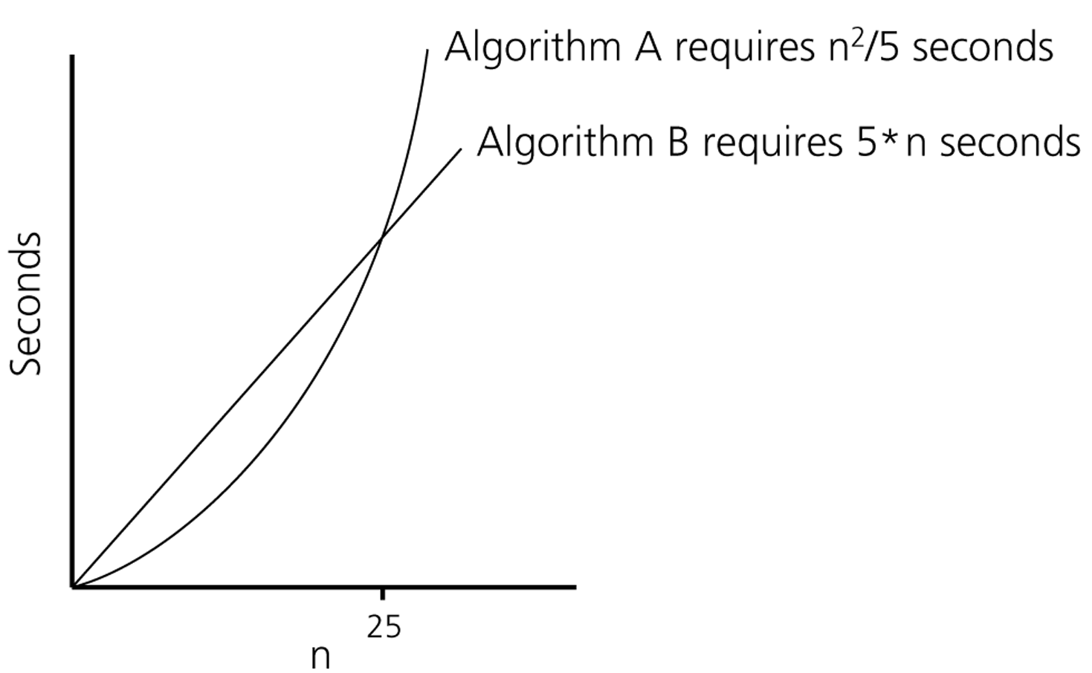
Algorithm Growth Rates
Time requirements as a function
of the problem size n

Slide 14
Common Growth Rates
Function | Growth Rate Name
c | Constant
log N | Logarithmic
log² N | Log-squared
N | Linear
N log N | Log-linear
N² | Quadratic
N³ | Cubic
2^{N} | Exponential

Slide 15
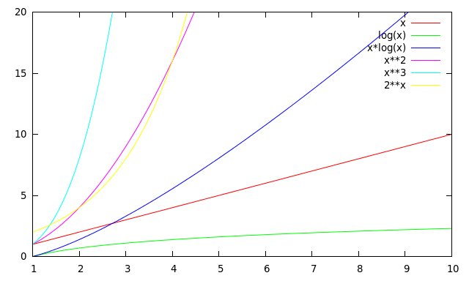
Running Times for Small Inputs
Input size (x = n)

Slide 16
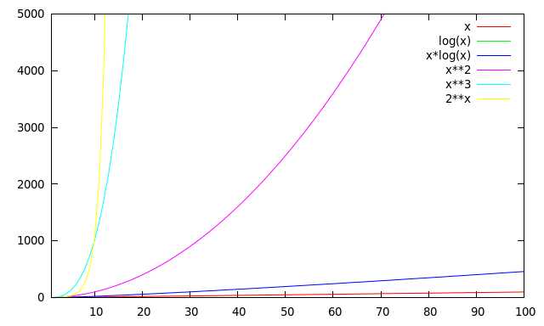
Running Times for Large Inputs
Running time
Input size (x = n)

Slide 17
Order-of-Magnitude Analysis and Big O Notation
If Algorithm A requires time proportional to g(n), Algorithm A is said to be order g(n), and it is denoted as O(g(n)).
The function g(n) is called the algorithm’s growth-rate function.
Since the capital O is used in the notation, this notation is called the Big O notation.
If Algorithm A requires time proportional to n², it is O(n²).
If Algorithm A requires time proportional to n, it is O(n).

Slide 18
Definition of the Order of an Algorithm
Definition:
Algorithm A is order g(n) – denoted as O(g(n)) – if constants k and n₀ exist such that A requires no more than k*g(n) time units to solve a problem of size n ≥ n₀. ➔ f(n) ≤ k*g(n) for all n ≥ n₀
The requirement of n ≥ n₀ in the definition of O(f(n)) formalizes the notion of sufficiently large problems.
In general, many values of k and n can satisfy this definition.

Slide 19
Order of an Algorithm
If an algorithm requires f(n) = n²–3*n+10 seconds to solve a problem size n. If constants k and n₀ exist such that
k*n² ≥ n²–3*n+10 for all n ≥ n₀ .
the algorithm is order n² (In fact, k is 3 and n₀ is 2)
3*n² ≥ n²–3*n+10 for all n ≥ 2 .
Thus, the algorithm requires no more than k*n² time units for n ≥ n₀ ,
So it is O(n²)

Slide 20
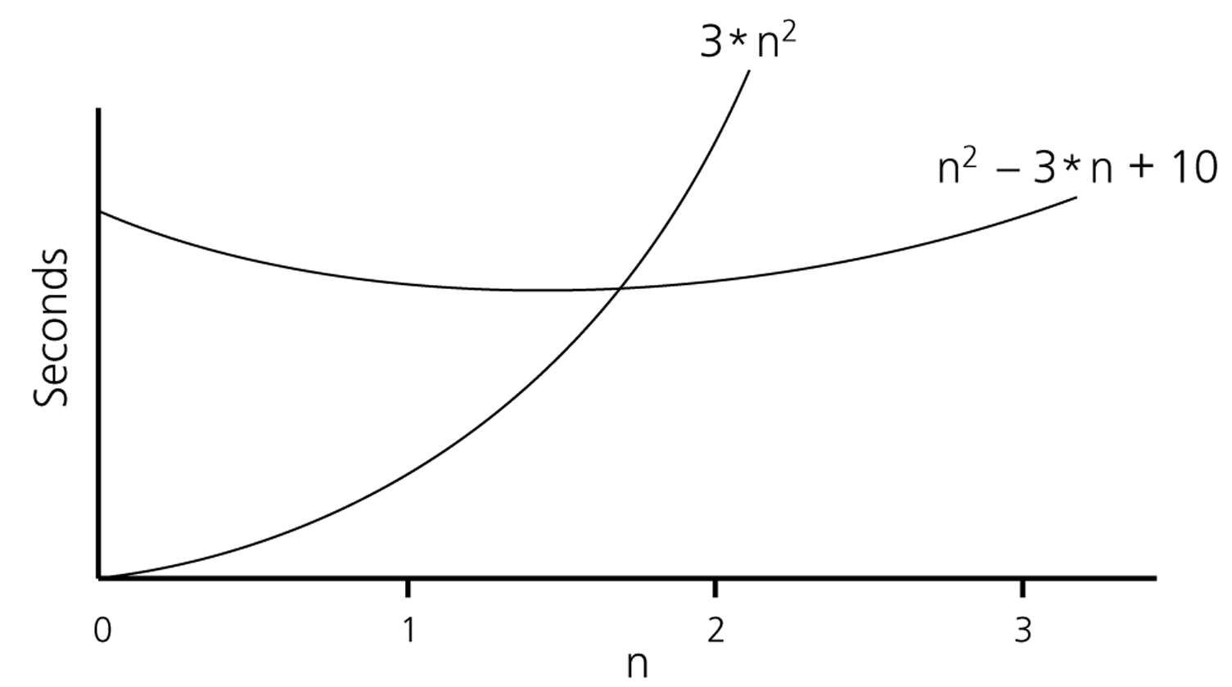
Order of an Algorithm

Slide 21
Order of an Algorithm
Show 2^{x} + 17 is O(2^{x})
2^{x} + 17 ≤ 2^{x} + 2^{x} = 2*2^{x} for x > 5
Hence k = 2 and n₀ = 5

Slide 22
Order of an Algorithm
Show 2^{x} + 17 is O(3^{x})
2^{x} + 17 ≤ k3^{x}
Easy to see that rhs grows faster than lhs over time → k=1
However when x is small 17 will still dominate → skip over some smaller values of x by using n₀ = 2
Hence k = 1 and n₀ = 2

Slide 23
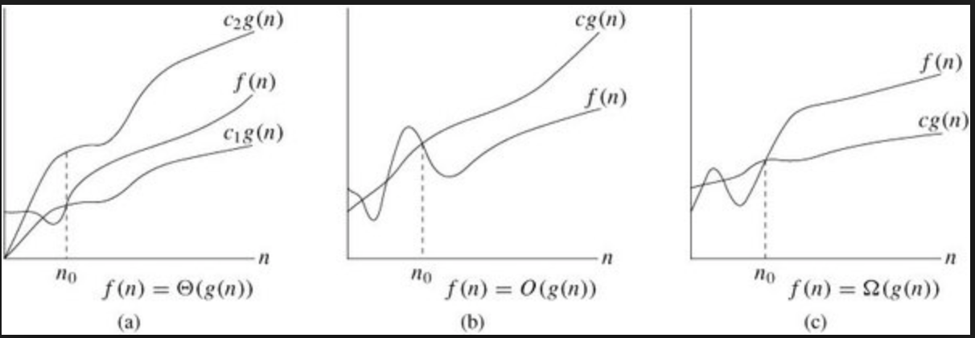
Definition of the Order of an Algorithm
Definition:
Algorithm A is omega g(n) – denoted as Ω(g(n)) – if constants k and n₀ exist such that A requires more than k*g(n) time units to solve a problem of size n ≥ n₀. ➔ f(n) ≥ k*g(n) for all n ≥ n₀

Slide 24
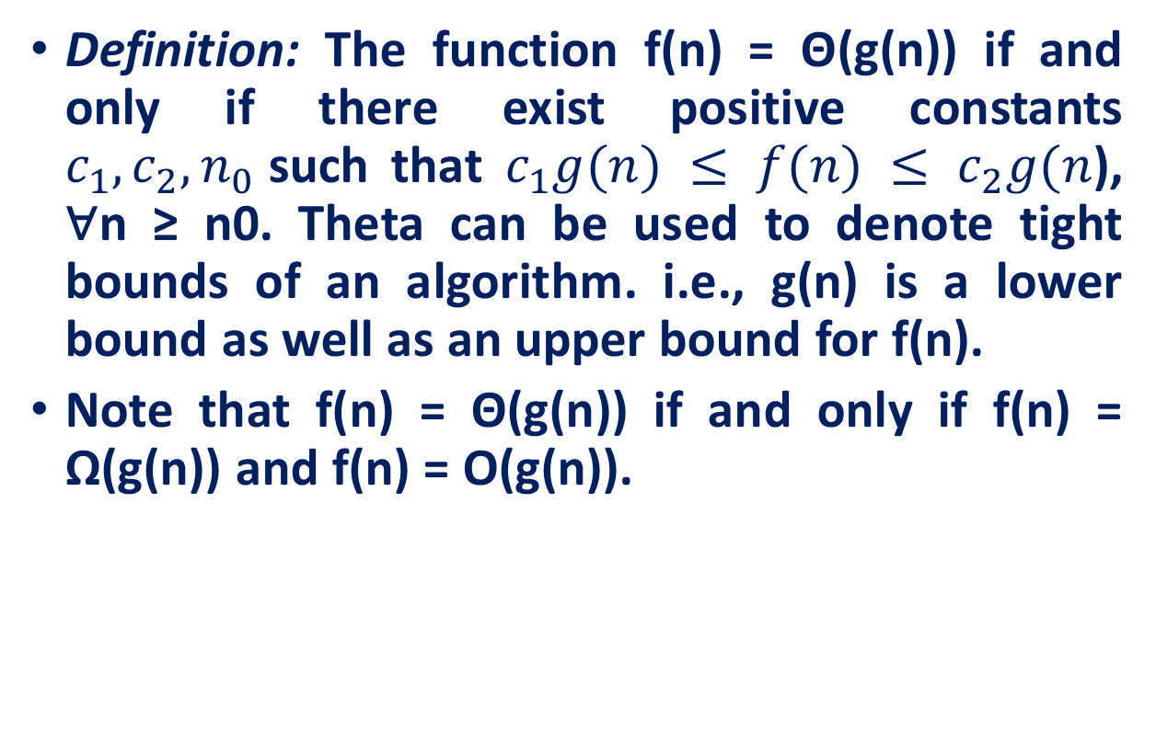
Definition of the Order of an Algorithm
Definition: The function f(n) = Θ(g(n)) if and only if there exist positive constants $c_{1}, c_{2}, n_{0}$such that $c_{1}g(n) ≤ f(n) ≤ c_{2}g(n$), ∀n ≥ n0. Theta can be used to denote tight bounds of an algorithm. i.e., g(n) is a lower bound as well as an upper bound for f(n).
Note that f(n) = Θ(g(n)) if and only if f(n) = Ω(g(n)) and f(n) = O(g(n)).
24

Slide 25

Order of an Algorithm
Show f(n) = 7n² + 1 is 𝚹(n²)
You need to show f(n) is O(n²) and f(n) is Ω(n²)
f(n) is O(n²) because 7n² + 1 ≤ 7n² + n² ∀n ≥ 1 ➔ k₂ = 8 n₀ = 1
f(n) is Ω (n²) because 7n² + 1 ≥ 7n² ∀n ≥ 0 ➔ k₁ = 7 n₀ = 0
Pick the largest n₀ to satisfy both conditions naturally ➔ k₁ = 8, k₂ = 7, n₀ = 1

Slide 26
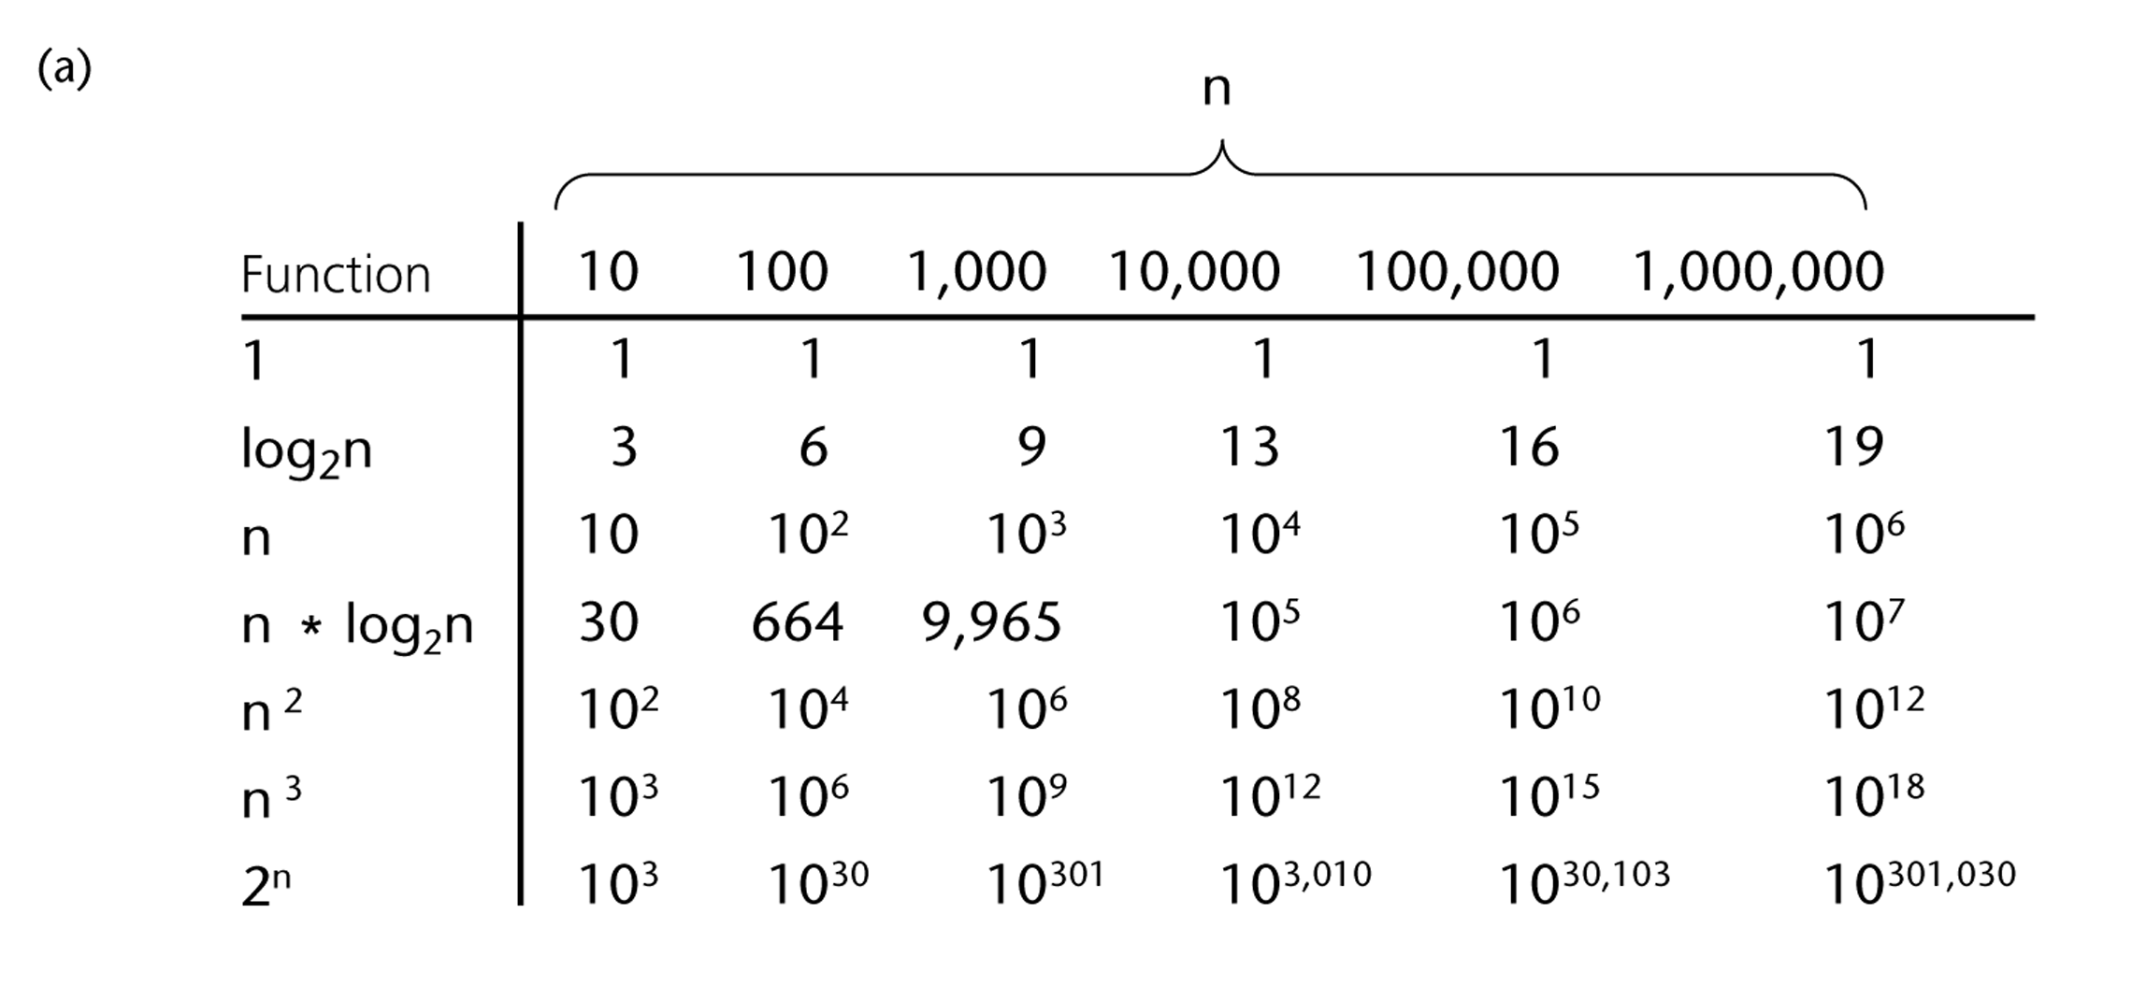
A Comparison of Growth-Rate Functions
26

Slide 27
Growth-Rate Functions
O(1) Time requirement is constant, and it is independent of the problem’s size.
O(log₂n) Time requirement for a logarithmic algorithm increases increases slowly
as the problem size increases.
O(n) Time requirement for a linear algorithm increases directly with the size
of the problem.
O(n*log₂n) Time requirement for a n*log₂n algorithm increases more rapidly than
a linear algorithm.
O(n²) Time requirement for a quadratic algorithm increases rapidly with the
size of the problem.
O(n³) Time requirement for a cubic algorithm increases more rapidly with the
size of the problem than the time requirement for a quadratic algorithm.
O(2^{n}) As the size of the problem increases, the time requirement for an
exponential algorithm increases too rapidly to be practical.
27

Slide 28
Growth-Rate Functions
If an algorithm takes 1 second to run with the problem size 8, what is the time requirement (approximately) for that algorithm with the problem size 16?
If its order is:
O(1) ➔ T(n) = 1 second
O(log₂n) ➔ T(n) = (1*log₂16) / log₂8 = 4/3 seconds
O(n) ➔ T(n) = (1*16) / 8 = 2 seconds
O(n*log₂n) ➔ T(n) = (1*16*log₂16) / 8*log₂8 = 8/3 seconds
O(n²) ➔ T(n) = (1*16²) / 8² = 4 seconds
O(n³) ➔ T(n) = (1*16³) / 8³ = 8 seconds
O(2^{n}) ➔ T(n) = (1*2¹⁶) / 2⁸ = 2⁸ seconds = 256 seconds

Slide 29
Properties of Growth-Rate Functions
We can ignore low-order terms in an algorithm’s growth-rate function.
If an algorithm is O(n³+4n²+3n), it is also O(n³).
We only use the higher-order term as algorithm’s growth-rate function.
We can ignore a multiplicative constant in the higher-order term of an algorithm’s growth-rate function.
If an algorithm is O(5n³), it is also O(n³).
O(f(n)) + O(g(n)) = O(f(n)+g(n))
We can combine growth-rate functions.
If an algorithm is O(n³) + O(4n), it is also O(n³ +4n²) ➔ So, it is O(n³).
Similar rules hold for multiplication.

Slide 30
Growth-Rate Functions – Example1
Cost Times
i = 1; c1 1
sum = 0; c2 1
while (i <= n) { c3 n+1
i = i + 1; c4 n
sum = sum + i; c5 n
}
T(n) = c1 + c2 + (n+1)*c3 + n*c4 + n*c5
= (c3+c4+c5)*n + (c1+c2+c3)
= a*n + b
➔ So, the growth-rate function for this algorithm is O(n)
30

Slide 31
Growth-Rate Functions – Example2
Cost Times
i=1; c1 1
sum = 0; c2 1
while (i <= n) { c3 n+1
j=1; c4 n
while (j <= n) { c5 n*(n+1)
sum = sum + i; c6 n*n
j = j + 1; c7 n*n
}
i = i +1; c8 n
}
T(n) = c1 + c2 + (n+1)*c3 + n*c4 + n*(n+1)*c5+n*n*c6+n*n*c7+n*c8
= (c5+c6+c7)*n² + (c3+c4+c5+c8)*n + (c1+c2+c3)
= a*n² + b*n + c
➔ So, the growth-rate function for this algorithm is O(n²)
31

Slide 32
Growth-Rate Functions – Example3
for (i=1; i<=n; i++)
for (j=1; j<=i; j++)
for (k=1; k<=j; k++)
x=x+1;
T(n) =
➔ So, the growth-rate function for this algorithm is O(n³)
32

Slide 33
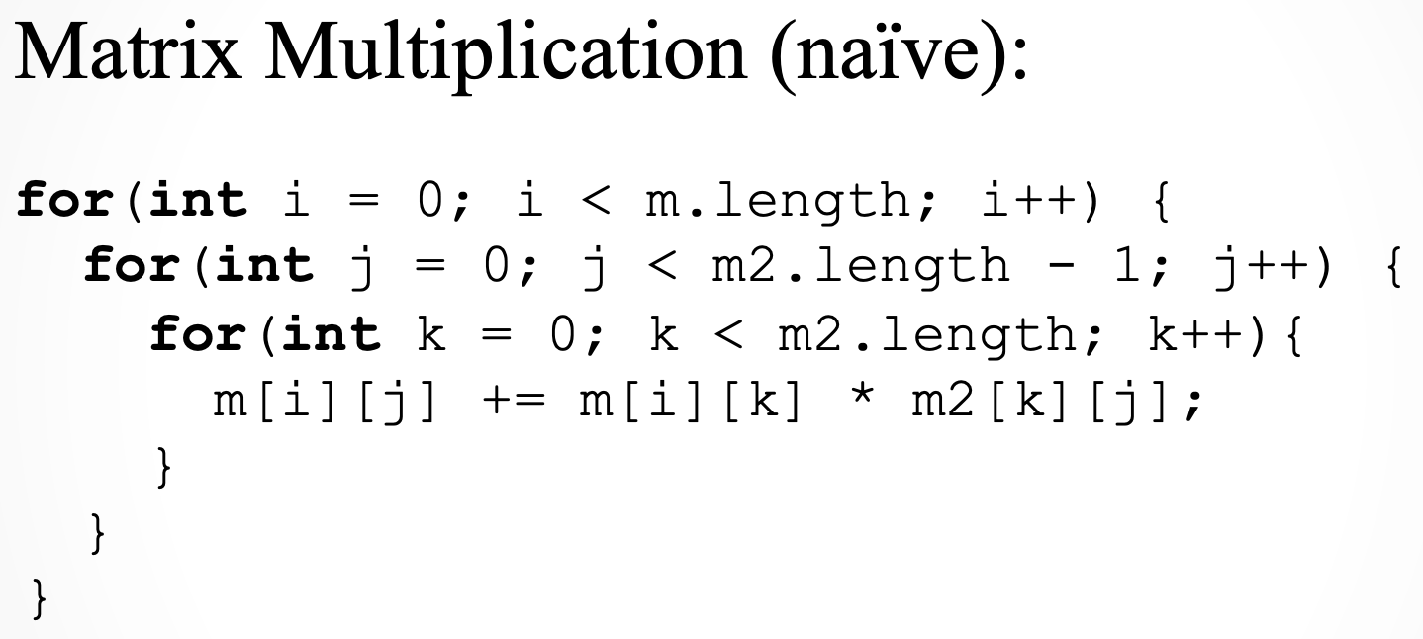

Growth-Rate Functions – Examples 3 & 4
For nxn matrices, time complexity is: O(n³)
How about this one? O(logn)
33

Slide 34
Growth-Rate Functions Recursive Algorithms
int fact(int n) {
if (n ==0)
return (1);
else
return (n * fact(n-1));
}
T(n) = T(n-1) + c
= (T(n-2) + c) + c
= (T(n-3) + c) + c + c
= (T(n-i) + i*c)
when i=n → T(0) + n*c ➔ T(n) = O(n)

Slide 35
Tracing the call fact (3)
N = 3 if (N==0) false return (3*fact(2))
After original call
N = 2 if (N==0) false return (2*fact(1))
N = 3 if (N==0) false return (3*fact(2))
After 1st call
N = 1 if (N==0) false return (1*fact(0))
N = 2 if (N==0) false return (2*fact(1))
N = 3 if (N==0) false return (3*fact(2))
After 2nd call
N = 0 if (N==0) true return (1)
N = 1 if (N==0) false return (1*fact(0))
N = 2 if (N==0) false return (2*fact(1))
N = 3 if (N==0) false return (3*fact(2))
After 3rd call

Slide 36
Tracing the call fact (3)
N = 1 if (N==0) false return (1* 1)
N = 2 if (N==0) false return (2*fact(1))
N = 3 if (N==0) false return (3*fact(2))
After return from 3rd call
N = 2 if (N==0) false return (2* 1)
N = 3 if (N==0) false return (3*fact(2))
After return from 2nd call
N = 3 if (N==0) false return (3* 2)
After return from 1st call
return 6

Slide 37
More Recursive Algorithms
bool isPalindrome (string s)
{ if (s.length() <= 1)
return true;
return (s[0]==s[s.length()-1]) && isPalindrome(s.substr(1,s.length()-2));
}
T(n) = T(n-2) + c
= (T(n-4) + c) + c
= (T(n-6) + c) + c + c
= (T(n-i) + i/2*c)
when i=n → T(0) + n/2*c ➔ T(n) = O(n)

Slide 38
What to Analyze
An algorithm can require different times to solve different problems of the same size.
Eg. Searching an item in a list of n elements using sequential search. ➔ Cost: 1,2,...,n
Worst-Case Analysis –The maximum amount of time that an algorithm require to solve a problem of size n.
This gives an upper bound for the time complexity of an algorithm.
Normally, we try to find worst-case behavior of an algorithm.
Best-Case Analysis –The minimum amount of time that an algorithm require to solve a problem of size n.
The best case behavior of an algorithm is NOT so useful.
Average-Case Analysis –The average amount of time that an algorithm require to solve a problem of size n.
Sometimes, it is difficult to find the average-case behavior of an algorithm.
We have to look at all possible data organizations of a given size n, and their distribution probabilities of these organizations.
Worst-case analysis is more common than average-case analysis.

Slide 39
Sequential Search
int sequentialSearch(const int a[], int item, int n){
for (int i = 0; i < n && a[i]!= item; i++);
if (i == n)
return –1;
return i;
}
Unsuccessful Search: ➔ O(n)
Successful Search:
Best-Case: item is in the first location of the array ➔O(1)
Worst-Case: item is in the last location of the array ➔O(n)
Average-Case: The number of key comparisons 1, 2, ..., n
➔ O(n)

Slide 40
Binary Search
We can do binary search if the array is sorted:
int binarySearch(int a[], int size, int x) {
int low =0;
int high = size –1;
int mid; // mid will be the index of
// target when it’s found.
while (low <= high) {
mid = (low + high)/2;
if (a[mid] < x)
low = mid + 1;
else if (a[mid] > x)
high = mid – 1;
else
return mid;
}
return –1;
}
40

Slide 41
Binary Search – Analysis
For an unsuccessful search:
The number of iterations in the loop is ⎣log₂n⎦ + 1
➔ O(log₂n)
For a successful search:
Best-Case: The number of iterations is 1. ➔ O(1)
Worst-Case: The number of iterations is ⎣log₂n⎦ +1 ➔ O(log₂n)
Average-Case: The avg. # of iterations < log₂n ➔ O(log₂n)
0 1 2 3 4 5 6 ← an array with size 7
3 2 3 1 3 2 3 ← # of iterations
The average # of iterations = 17/7 = 2.4285 < log₂7
41

Slide 42
How much better is O(log2n)?
n O(log₂n)
16 4
64 6
256 8
1024 10
16,384 14
131,072 17
262,144 18
524,288 19
1,048,576 20
1,073,741,824 30
42

Slide 43
References
Data Structure and Algorithms for Electrical Engineering by Yung Yi
CENG707 - Data Structures and Algorithms by Yusuf Sahillioğlu

